Slide 1
Interesting case
Diagnosis : rupture globe right eye
Operation : repair globe right eye

Slide 2
History
Case ผู้ป่วยชายไทย อายุ 42 ปี
Chief complaint : ปวดตาขวา 8 ชม ก่อนมา รพ.
Present illness : 8 ชม. ก่อนมา รพ. ขณะงัดท่อนไม้ ไม้กระเด็นกระแทกตาด้านขวา ปวดตา ลืมตาไม่ขึ้น รู้สึกเหมือนมีน้ำไหลออกจากลูกตา ตามัวมองไม่ชัด ไม่สลบ จำเหตุการณ์ได้ จึงล้างตาเองอาการไม่ดีขึ้นจึงไป รพ.วิภาราม แล้วส่งตัวมารักษาต่อที่ รพ.พระมงกุฎเกล้า

Slide 3
History taking ?? R1

Slide 4
History
ไม่มีอุบัติเหตุร่วมอื่นๆ
ที่ รพ. วิภาราม ได้ให้ management
Npo – 5DN/2 1000 ml IV rate 100 ml/hr
Eye shield
ATB
Cefazolin 1 gm IV q 6 hr
Gentamycin 240 mg IV OD

Slide 5
Past history
Underlying disease : HT, DLP
No drug allergy
No history of surgery
No history of smoking or drinking alcohol
NPO time : 9 hr
Functional class I

Slide 6
Past history
Medication
Manidipine (20) 1x1pc
Enalapril (5) 1hs
Atorvastatin (20) 1hs

Slide 7
Physical examination
A Thai man, good conciousness
BW : 81 kg , Height 158 cm BMI : 32.4 kg/m2
V/S : BP 133/83 mmHg HR 56 bpm BT 36.4°C RR 15 /min
Right eye : cornea laceration, subconjunctival hemorrhage, iris prolapse, peak pupil (on eye shield)
Left eye : normal,
VA : Rt. eye 5/200 : , Lt. eye : 20/20

Slide 8
Physical examination
Airway examination
No limit neck of motion
Thyromental distance > 6 cm
Mouth opening > 3 cm
Full ROM of neck
Permanent tooth, no loosing, no missing
No prominent incisor

Slide 9
Physical examination
RS : no tachypnea, equal breath sound, no adventitious sound
CVS : pulse full and regular, no heaving, no thrill, normal S1S2, no murmur
Abdomen : soft, not tender, no guarding, no rebound tenderness
Extremities : no wound, no deformity, no edema
Neuro : E4V5M6, no facial palsy, motor grade V all

Slide 10
R1 Investigation ??

Slide 11
Investigation
CBC :
Hb = 16 gm/dL Hct = 49 % Platelet = 325,000 /mm3
Electrolyte :
Na = 139 K = 4.0 Cl = 107 HCO3 = 24 BUN : 15.3 g/dL Cr : 0.85 mg/d
CXR : no infiltration, no cardiomegaly
EKG : NSR rate 60 bpm

Slide 12
R1 Problem List?

Slide 13
R1 Problem List?
Rupture globe at Right eye
Obesity
Underlying disease: HT DLP

Slide 14
ASA classification
ASA class II E

Slide 15
Preoperative evaluation and preparation R2?

Slide 16
Preoperative evaluation
1. Ruptured globe injury :
Exclude associated injury
Discuss goal of treatment with ophthalmologist
Prevent increased IOP
Prevent medication that induce nausea/vomiting
Surgery should be perform within 12 hr. to minimized infection and others complication

Slide 17
Preoperative evaluation
2. Obesity
Difficult airway
OSA

Slide 18
Preoperative evaluation
Hypertension
Continue anti-hypertensive drug
Exam end organ damage : cardiac , renal , cerebral involvement
Evaluated EKG, CXR, serum creatinine to evaluate end organ damaged

Slide 19
Preparation
NPO
Inform Consent
Force air warmer
Warm Isotonic fluid
No G/M blood component
Prepare drug for blunt airway reflex (such as lidocaine , esmolol, labetalol)
Difficult airway management Ex. Video laryngoscope

Slide 20
Choice of Anesthesia
GA , RA or LA?

Slide 21
Choice of Anesthesia
Regional anesthesia (Retrobulbar or peribulbar)
Increase IOP (volume of local anesthesia)
Not Fully immobilize
Local anesthesia with IV sedation
Use when GA is contraindicated

Slide 22
Choice of Anesthesia
General anesthesia
Preferred technique for open-globe injuries
Fully immobilize
No time limit for the procedure

Slide 23
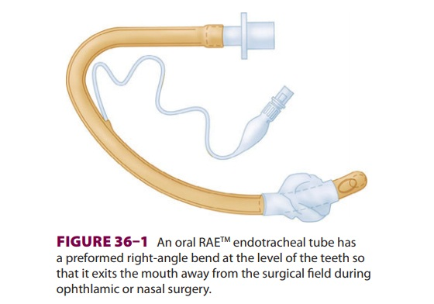
Intraoperative
Choice of anesthesia : GA with Oral RAE
Monitoring
NIBP, SpO2, EKG, EtCO2
TOF
Position : Supine

Slide 24
Anesthetic consideration R3?

Slide 25
Anesthetic consideration
Control intraocular pressure
Smooth induction and intubation
Maintain IOP
Smooth emergence and extubation
Concern severe oculocardiac reflex
Motionless field

Slide 26
Smooth endotracheal intubation
Prevent the rising of BP, HR during intubation
Fentanyl 7-8 mcg/kg IV with induction
Lidocaine 1.5 mg/kg IV 2min before intubation
Nicardipine 0.015-0.03 mg/kg IV 2min before intubation
Esmolol 0.5-2 mg/kg IV
Labetalol 0.15-0.45 mg/kg IV

Slide 27
Maintain IOP
Normal IOP : 10-21.7 mmHg (abnormal > 22 mmHg)
Cough, strain or vomiting increase IOP 30-40 mmHg
Forceful eyelid squeeze increase IOP more than 50 mmHg

Slide 28
Maintain IOP
3 main factors influencing IOP
1. External pressure on the eye
Contraction of EOM
Venous congestion of orbital vein (vomiting, coughing)
Orbital tumor
2. Scleral rigidity
3. Changes in intraocular content : semisolid (lens vitreous intraocular tumor) , fluid

Slide 29
Factors influencing IOP
Inhalation agents
Reduced aqueous humor production
Facilitation of aqueous humor outflow
Decreased extraocular muscle tension
Lowered blood pressure
Depression of CNS control center
Increase choroidal volume elevate IOP
• Hypercapnia cause choroidal congestion
Ketamine cause nystagmus, blepharospasm modest increase in IOP
Etomidate induced myoclonus may increase IOP hazardous in ruptured globe

Slide 30
Prevent increase IOP
Avoid direct pressure on the globe
No retrobulbar or peribulbar injection
Careful face mask technique
Avoid increase in CVP
Prevent coughing during induction and intubation
Ensure a deep level of anesthesia prior laryngoscopy
Avoid head down position

Slide 31
Smooth emergence and Extubation
Deep extubation?
Blunt Sympathetic response

Slide 32
Deep extubation?
Contraindication
Difficult ventilation or intubation
Obesity
Obstructive sleep apnea
Risk of aspiration pneumonitis
Risk of airway swelling
Modern techniques of eye repair involve minimal risk of suture disruption with coughing

Slide 33
Deep Extubation
Finish operation
Reverse muscle relaxant but continue volatile
Spontaneous ventilation : Tidal volume and respiratory rate
Suction secretion
Off endotracheal tube when TOF ratio > 0.9
Maintain airway under mask may use oral or nasal airway
Discontinue volatile and give 100 % oxygen
With 'deep' extubation, the ET tube is removed before wake-up and before the return of upper airway reflexes
ET tube is removed before wake-up and before the return of upper airway reflexes

Slide 34
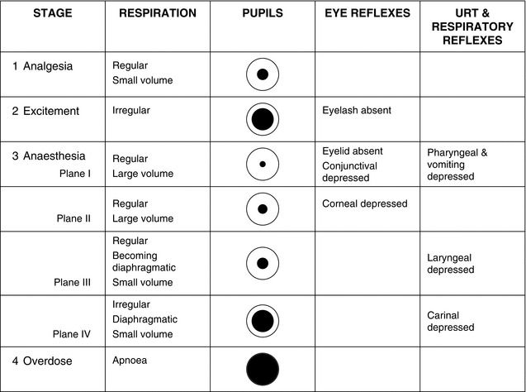

Slide 35
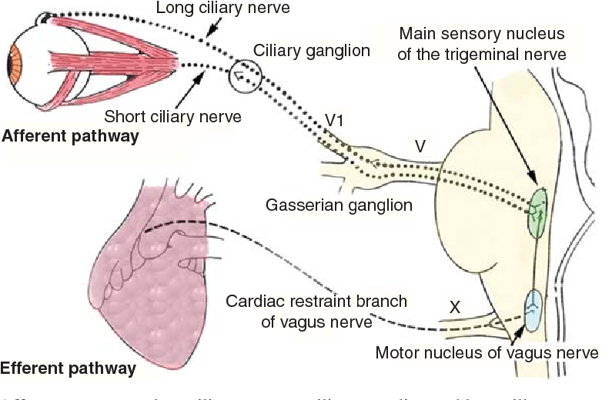
Oculocardiac reflex
Triggered by
Pressure on the globe
Traction on the EOM/conjunctiva/orbital structures
Pathway
Afferent limb : Trigeminal nerve
Efferent limb : Vagus nerve

Slide 36
Oculocardiac reflex
Manifestation
Bradycardia
Dysrhythmias
Cardiac arrest
Risk Factors
Light anesthesia
Hypoxemia and Hypercarbia

Slide 37
Oculocardiac reflex
Management
Notify surgeon and stop stimuli (heart rate and rhythm return in 20 seconds)
Evaluation of adequate ventilation, oxygenation, depth of anesthesia
Medication
Atropine 0.02 mg/kg IV
Glycopyrrolate 0.01 mg/kg IV

Slide 38
Motionless field

Slide 39
Motionless field
Train-of-four stimulation
Four supramaximal stimuli given every 0.5 seconds (2 Hz)

Slide 40
Motionless field
Tetanic stimulation
The most commonly used is 50 Hz stimulation give for 5 second

Slide 41
Motionless field
PTC
Posttetanic response to single-twith stimulation given at 1 HZ starting 3 seconds after the end of tetanic stimulation

Slide 42
Motionless field

Slide 43
Motionless field
TOF 0.4 = lift the head or arm, Vt normal
TOF 0.6 = lift their head for 3 seconds, open their eyes widely
TOF 0.7 = cough, lift their head for 5 seconds , grip strength 60 percent
TOF 0.8 = Vc and inspiratory force are normal

Slide 44
Time in OR 18.15
Monitor
- NIBP, EKG, O2sat
- BP at OR 136/80 mmHg
- PR 54 / min

Slide 45
At 18.25
- Ramped position
Preoxygenation
Induction & intubation:
Fentanyl 50 mcg IV
Propofol 150+30+20 mg IV
Cisatracurium 10 mg IV
2℅xylocaine 120 mg IV
ETT oral RAE no 8 depth 22 cm

Slide 46
Maintainanc
- Air:O2:0.5:0.5 desfurane 6 %
Muscle relaxant: cisatracurium 6 mg
Analgesia : Fentanyl 50 mcg and MO 5 mg titration doses
Antiemitic : Ondrasetron 8 mg IV
Atorpine 0.6 mg IV

Slide 47
Total operation time : 2hr 15min Emergence
Awake extubation (obesity)
Reverse : Neostigmine 1.2 mg + Atropine 2.5 mg
IV fluid : Acetar 650 ml
EBL : minimal

Slide 48
Post operative
S: ตื่นรู้ตัวปกติ ไม่มีไข้ ปวดแผลเล็กน้อย หายใจได้ดีไม่เหนื่อย ไม่มีคลื่นไส้อาเจียน
O:
V/S : BP 150/90 , PR 60/min RR 18/min BT 36.6C
Right eye : VA 5/200 , mild lid swelling, mild conjunctival injection
Cardiovascular : normal s1s2, no murmur, regular rate
Respiratory : room air o2sat 100 %, lungs clear both
Extremities : no pitting edema

Slide 49
Post operative
A + P : Clinical stable
Adequate pain control: paracetamol (500) 1 tab oral prm q 4 hr
Nausea/vomiting prevention

Slide 50
Succinylcholine
May cause an increase in intraocular pressure (peak increase 9 mmHg)
Develops within 1 minute of injection
Peaks at 2-4 minute
Subsides by 6 minutes
Mechanism
Contraction of tonic myofibrils
Transient dilation of choroidal blood vessel
Producing a deepening of anterior chamber and increased outflow resistance

Slide 51
Succinylcholine
Sublingual nifedipine may attenuate the increase IOP caused by SCH
Precurarization or self-taming may attenuate the increase IOP from SCH

Slide 52
Techniques RSI

Slide 53
Priming
A small sub-paralyzing dose of the non-depolarizer (priming dose) 10% of intubating dose, 2-4 min before a large 2nd dose for tracheal intubation
Advantage
Alterative for Rapid sequence intubation
Avoid succinylcholine
Disadvantage
Visual disturbances (common) - Diplopia
Patient discomfort
Risks of aspiration

Slide 54
Priming

Slide 55
Precurarization
A small dose (10% of ED95) of a non-depolarizing neuromuscular blocking agent (NDMBA) a few (3.5-4) minutes before Succinylcholine
Advantage
Minimize these complications of SCH
Fasciculations
ICP, IGP, may IOP
Disadvantage
Required dose of SCH following precurarization dose is higher by about 50-100%.

Slide 56
Precurarization

Slide 57
Self taming technique
A small amount (1/5 of SCH or 5-10 mg ) of succinylcholine preceding the administration of full intubating dose during rapid sequence induction
Advantange
decrease the incidence and extent of fasciculations.

Slide 58
Self taming technique

Slide 59
Timing technique
A single bolus of nondepolarizing neuromuscular blocking drug followed by thiopental given at the onset of clinical weakness
Advantage
Alterative for Rapid Sequence Induction
Disadvantage
Patient discomfort
Difficult swallowing
Visual disturbances
Risks of aspiration

Slide 60
Timing technique

